Slide 1
MEASURE OF DISPERSION OR VARIATION

Slide 2
Measures of Variability
Measures of variability describe the spread or the dispersion of a set of data.
Common Measures of Variability
  Range
  Interquartile Range
  Mean Absolute Deviation
  Variance
  Standard Deviation
  Z scores
  Coefficient of Variation

Slide 3





Variability
No Variability in Cash Flow
Mean
Mean
Variability in Cash Flow
Mean
Mean

Slide 4
Variability
Variability
No Variability

Slide 5
Range
The difference between the largest and the smallest values in a set of data
Simple to compute
Ignores all data points
except the
two extremes
Example: Range = Largest - Smallest = 48 - 35 = 13
35
41
44
45
37
41
44
46
37
43
44
46
39
43
44
46
40
43
44
46
40
43
45
48

Slide 6

Interquartile Range
Range of values between the first and third quartiles
Range of the “middle half”
Less influenced by extremes

Slide 7
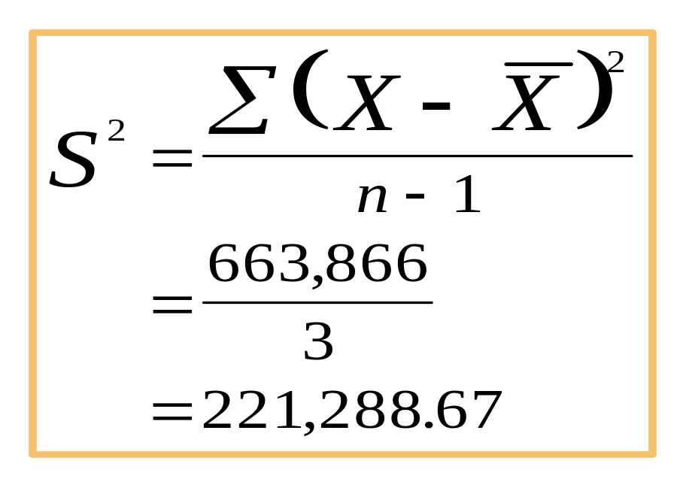
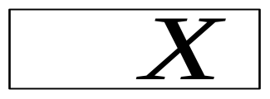
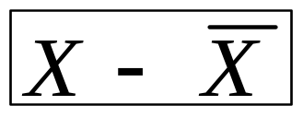
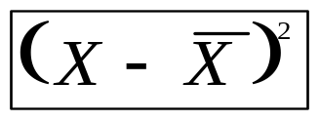
Sample Variance
Average of the squared deviations from the arithmetic mean
2,398
1,844
1,539
1,311
7,092
625
71
-234
-462
0
390,625
5,041
54,756
213,444
663,866

Slide 8
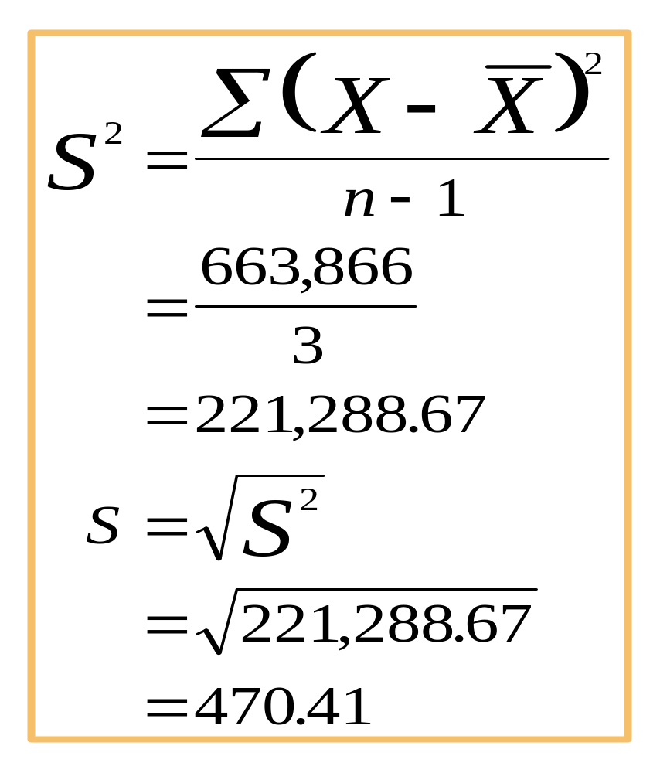
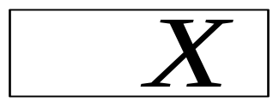
Sample Standard Deviation
Square root of the sample variance
2,398
1,844
1,539
1,311
7,092
625
71
-234
-462
0
390,625
5,041
54,756
213,444
663,866

Slide 9
Measures of Shape
Skewness
  Absence of symmetry
  Extreme values in one side of a distribution
Kurtosis
  Peakedness of a distribution

Slide 10
Skewness
Negatively
Skewed
Symmetric
(Not Skewed)
Positively
Skewed

Slide 11
Skewness
Mean
Mode
Mean
Median
Mode
Mode
Mean
Median
Median
Negatively
Skewed
Symmetric
(Not Skewed)
Positively
Skewed

Slide 12
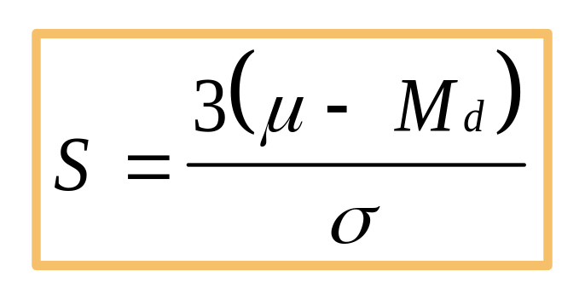
Coefficient of Skewness
Summary measure for skewness
If S < 0, the distribution is negatively skewed (skewed to the left).
If S = 0, the distribution is symmetric (not skewed).
If S > 0, the distribution is positively skewed (skewed to the right).

Slide 13
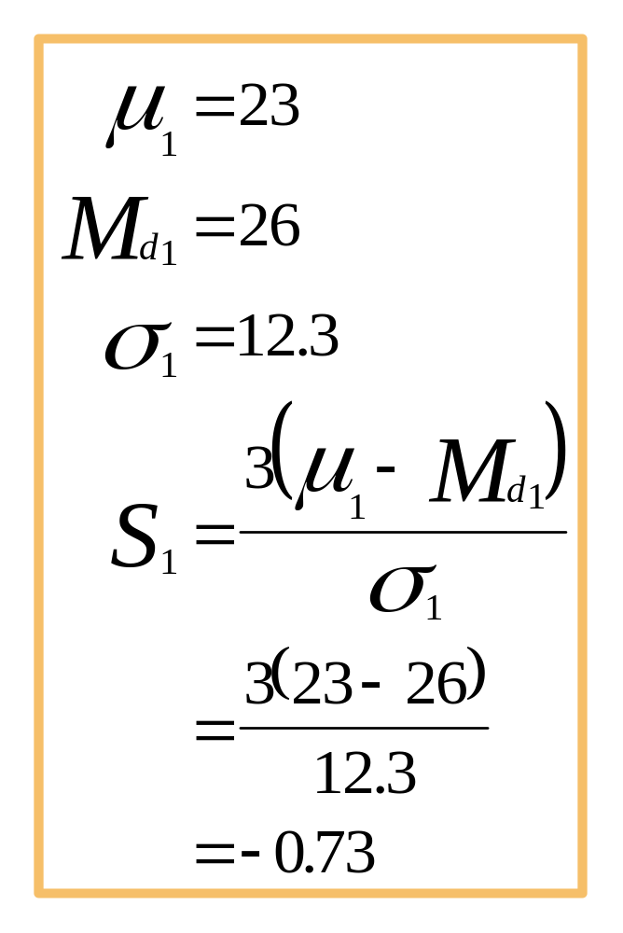
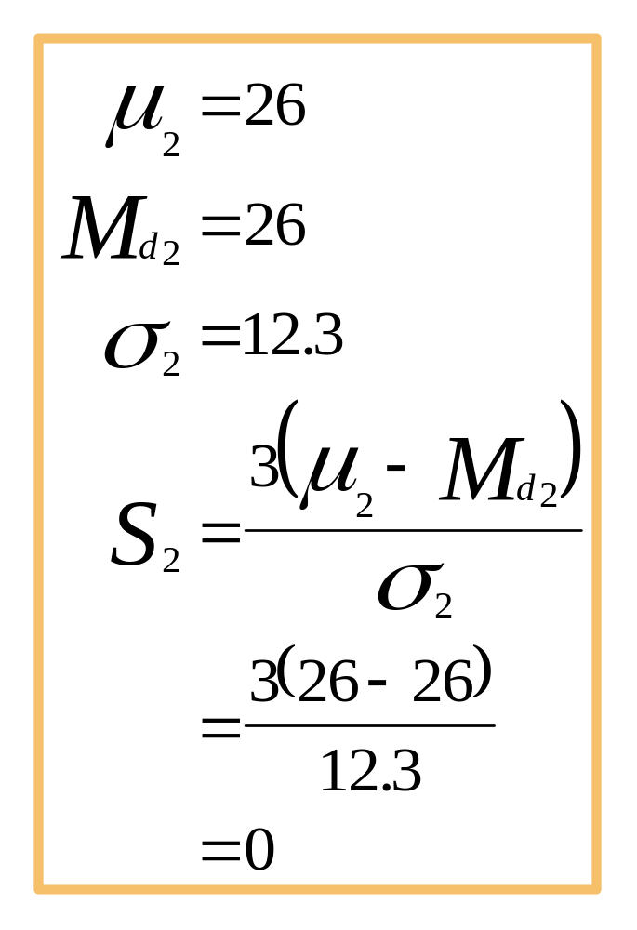
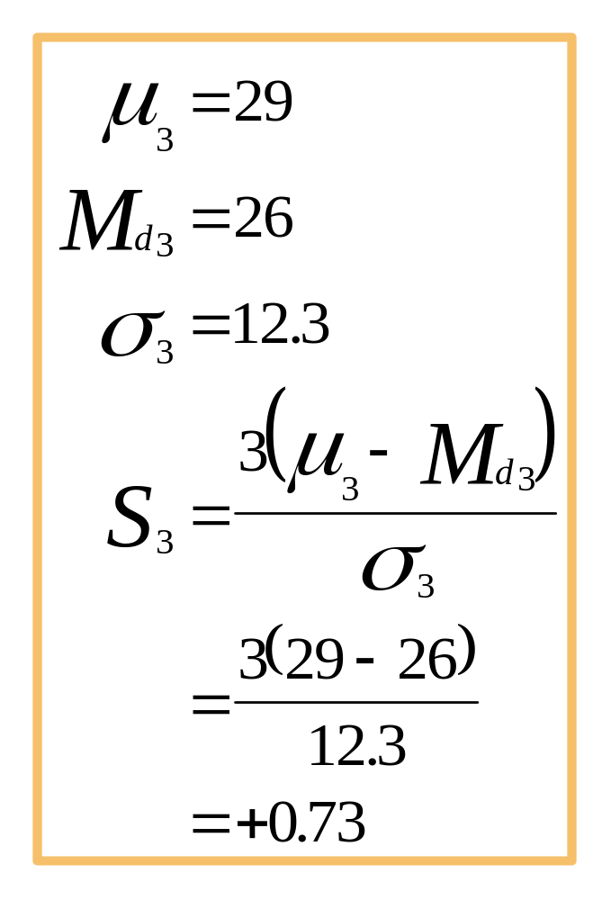
Coefficient of Skewness

Slide 14
Kurtosis
Peakedness of a distribution
  Leptokurtic: high and thin
  Mesokurtic: normal in shape
  Platykurtic: flat and spread out
Leptokurtic
Mesokurtic
Platykurtic
Slide 3-<number>

